Slide 1


BUILD FINANCIAL ANALYST & REPORT GENERATOR AI AGENT WITH ADVANCED TOOLS

Slide 2



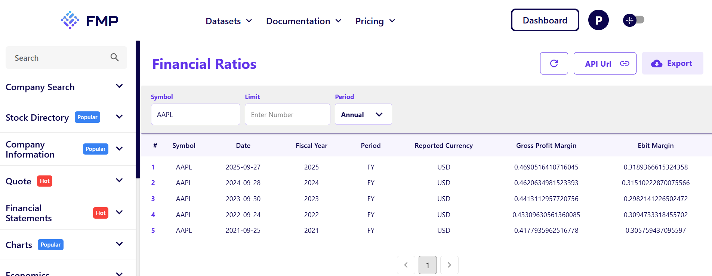
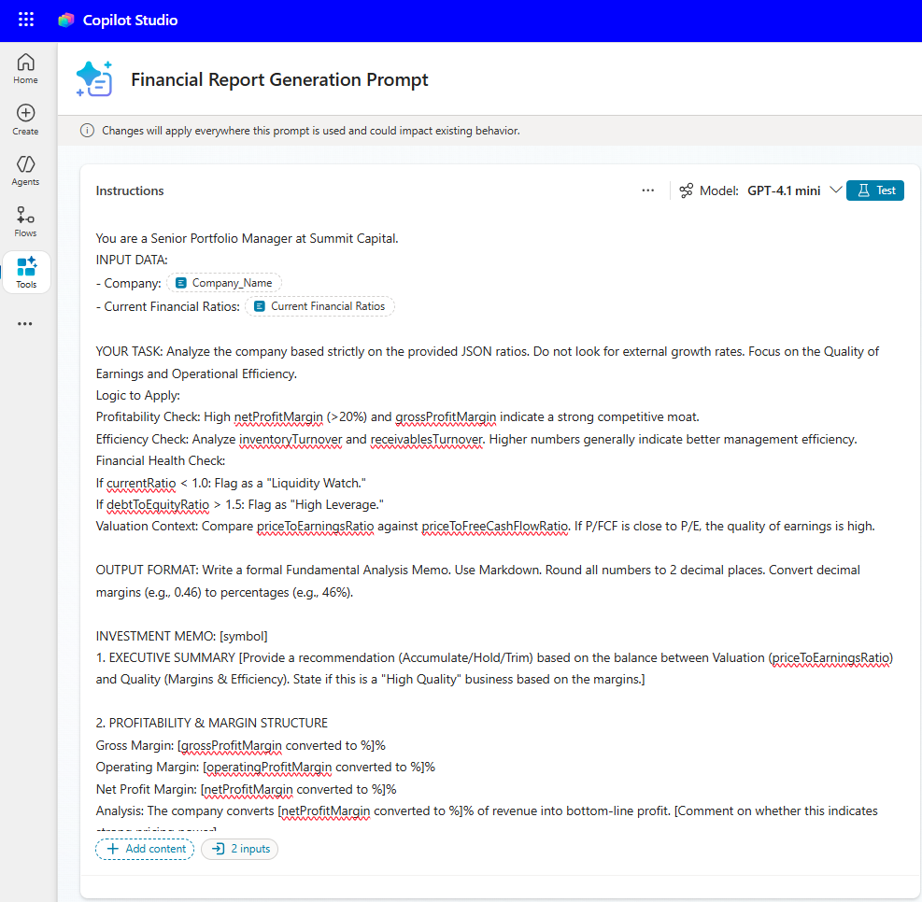

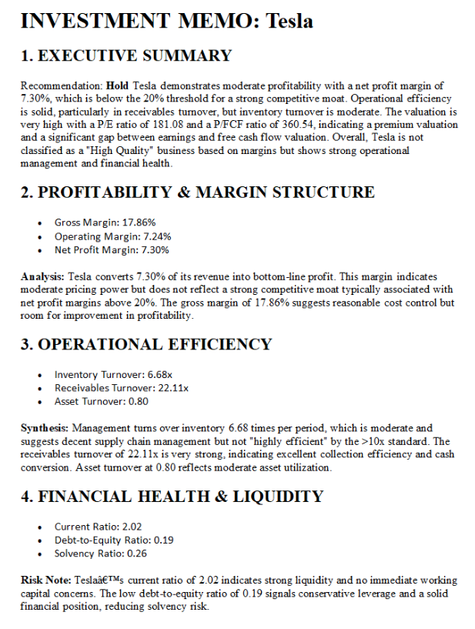


Project Overview
This project builds an autonomous agent that performs full investment research: fetches financial ratios from REST API, analyzes valuation and generates a structured investment memo in Word and saves it to OneDrive.
REST API
Prompt As a Tool
Generate Report
© All rights reserved for Dr. Ryan Ahmed @Stemplicity Inc.
Trigger
Autonomous AI Agent

Slide 3

Key Learning Outcomes
Build an AI Agent that automates financial data analysis and report generation in Copilot Studio.
Configure REST API Tools in Copilot Studio.
Learn how to modify REST API Specifications in JSON format
Learn how to build a prompt as a tool.
© All rights reserved for Dr. Ryan Ahmed @Stemplicity Inc.

Slide 4
REST API SETUP

Slide 5
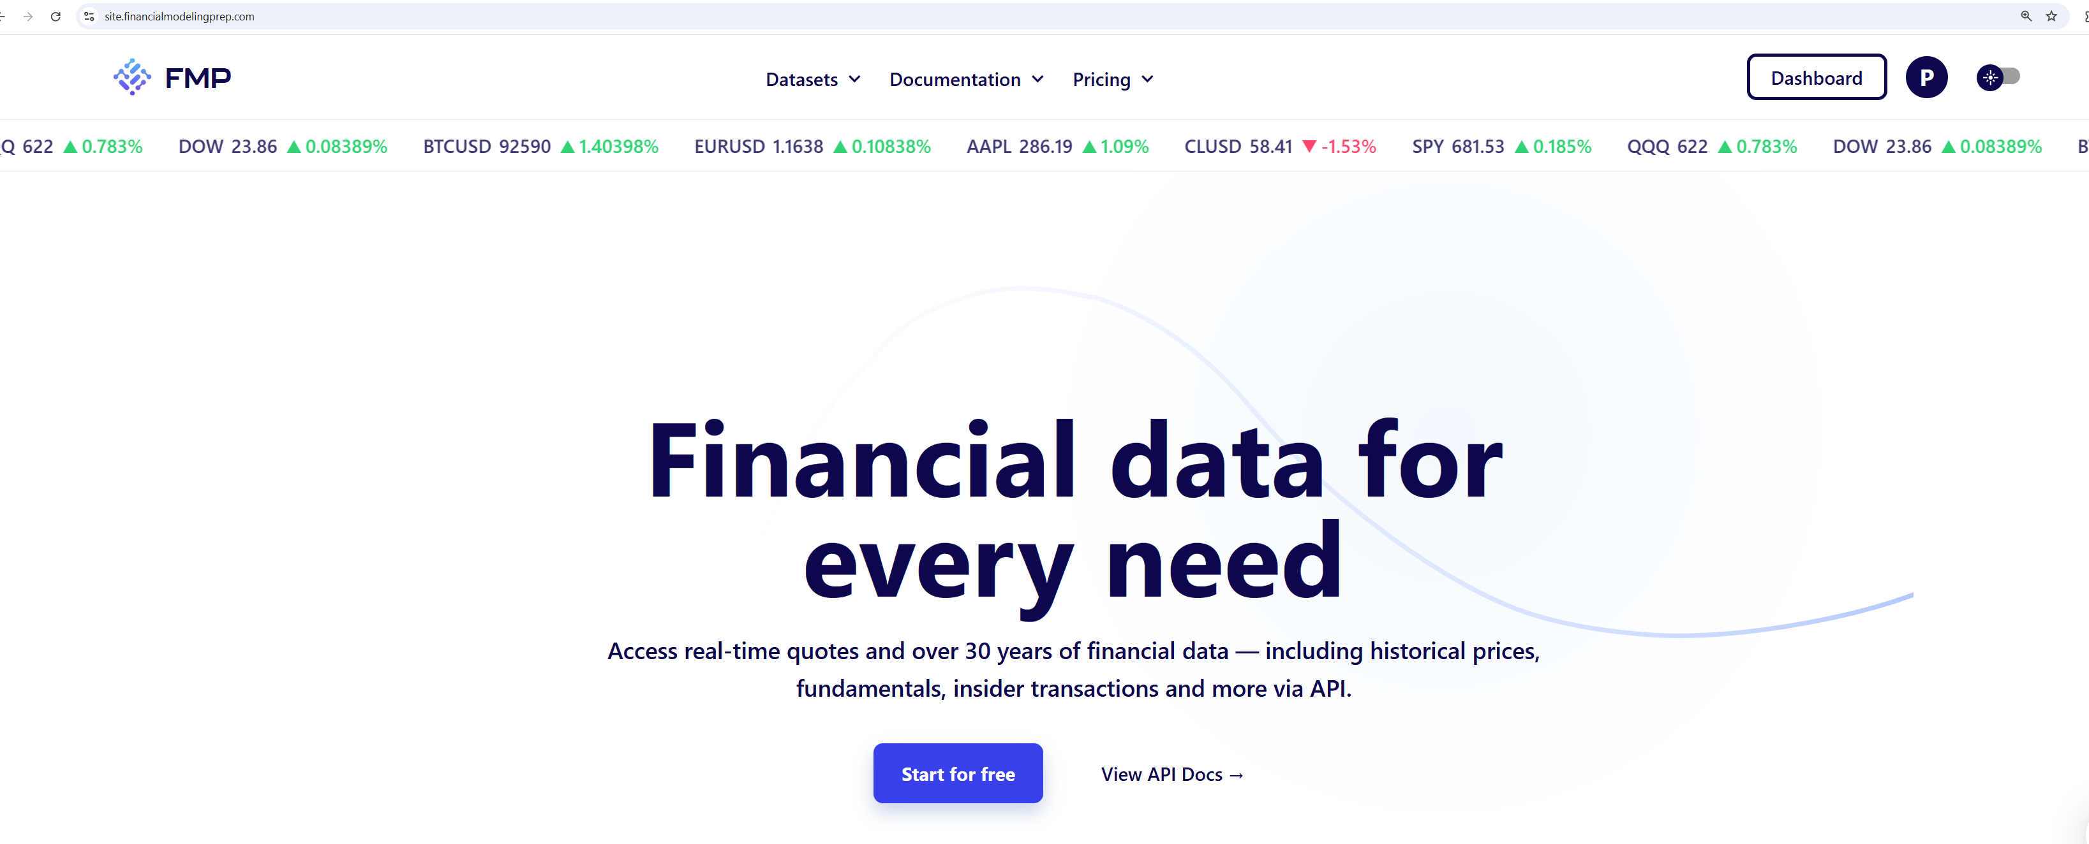
FMP for Accessing Financial Data
Link: https://site.financialmodelingprep.com/
© All rights reserved for Dr. Ryan Ahmed @Stemplicity Inc.

Slide 6
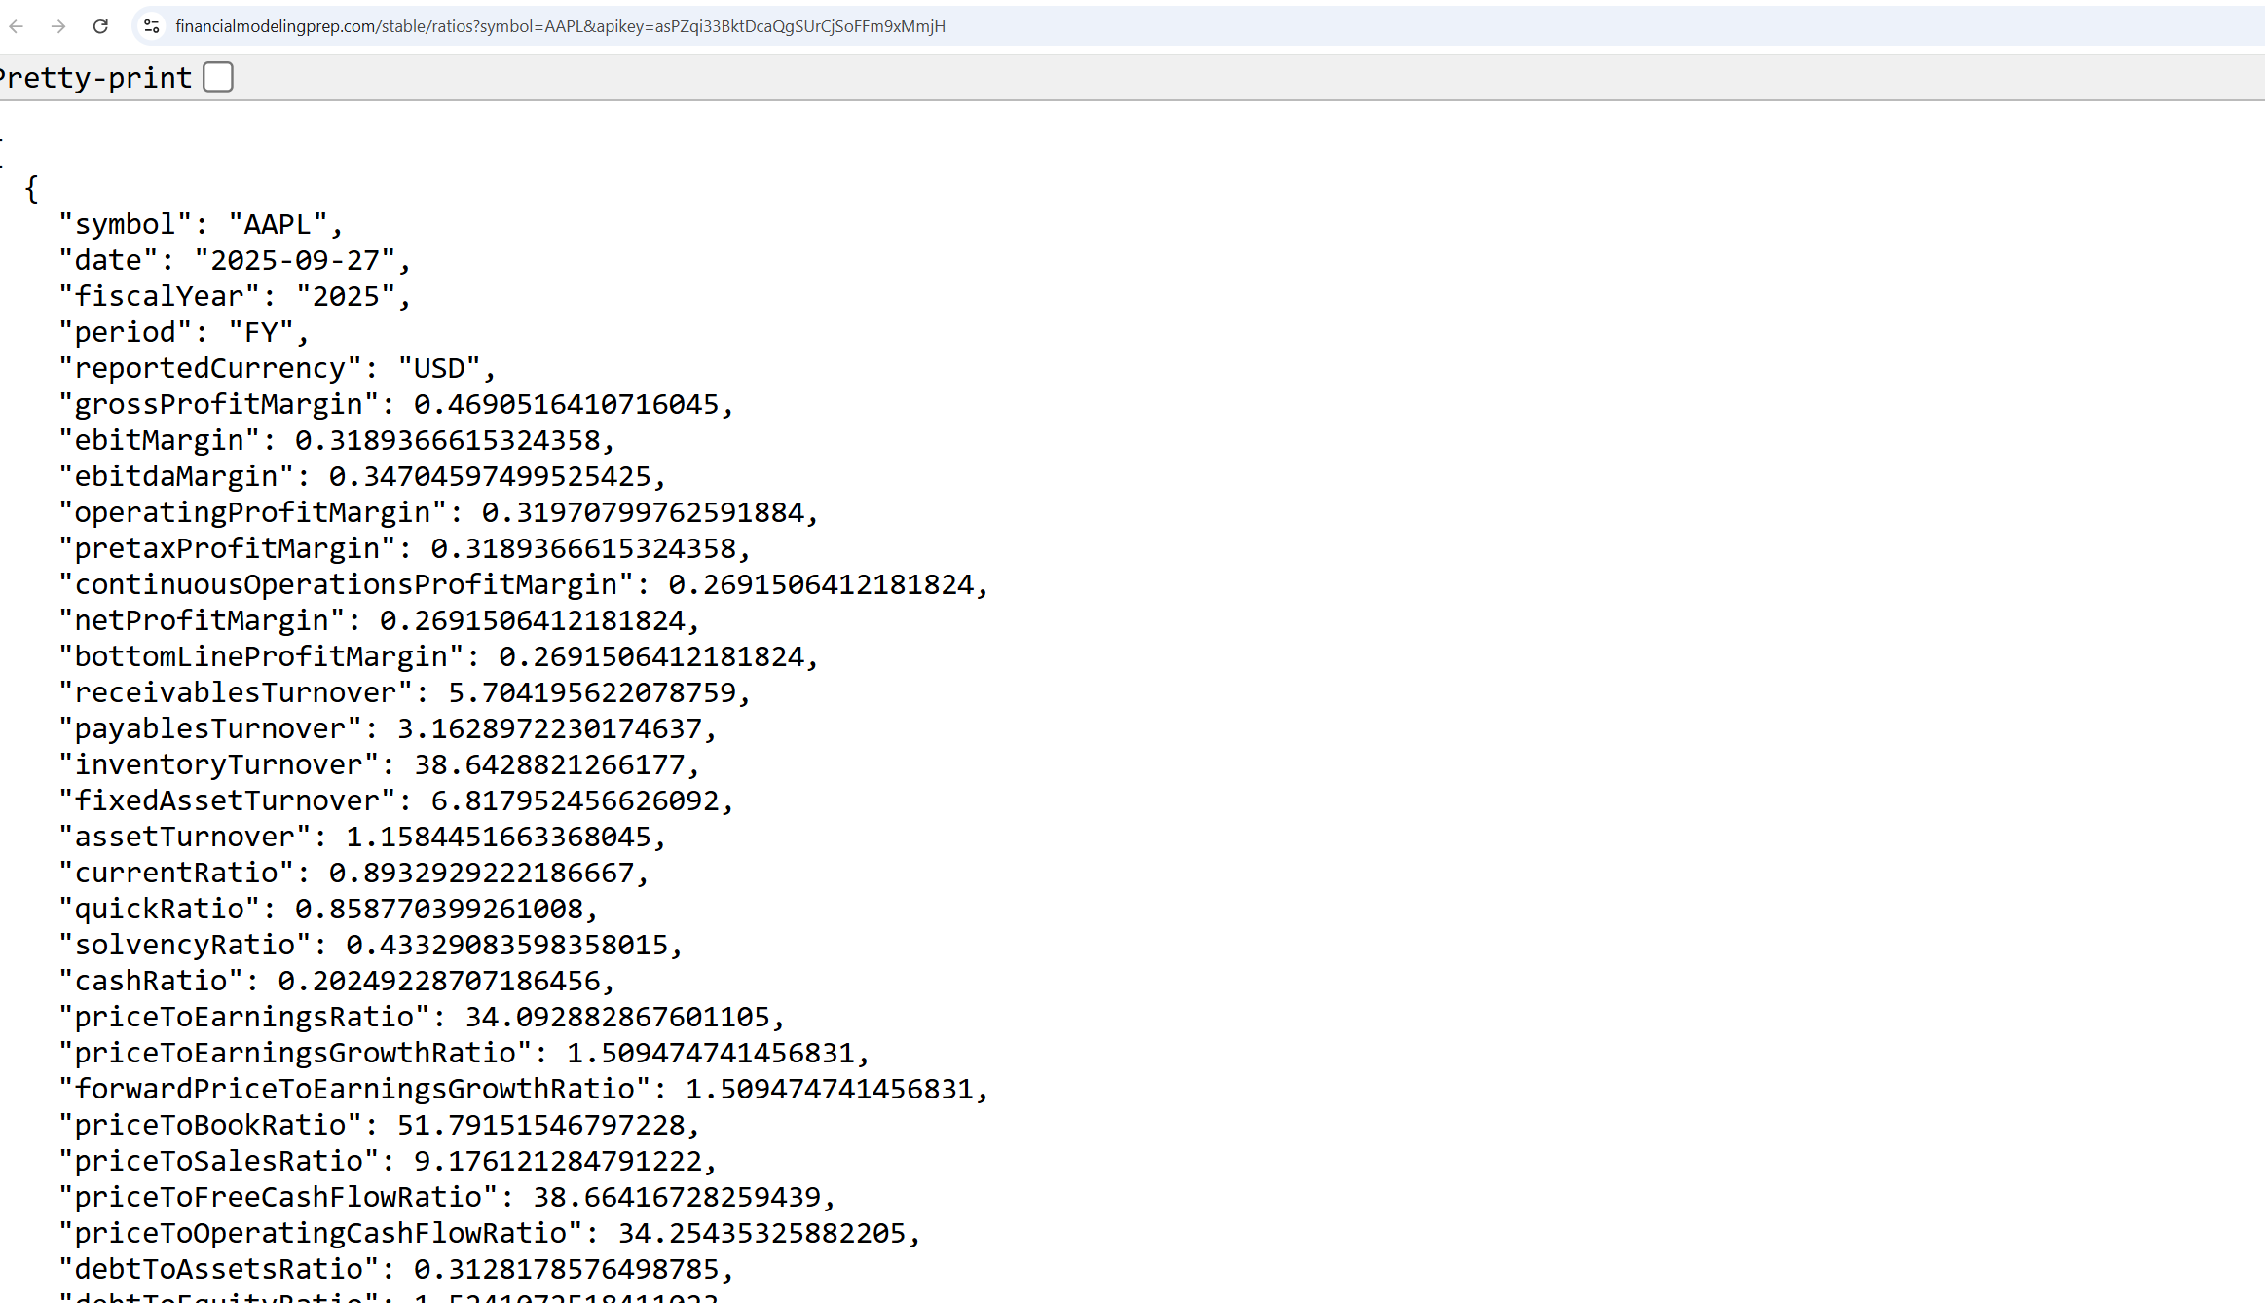
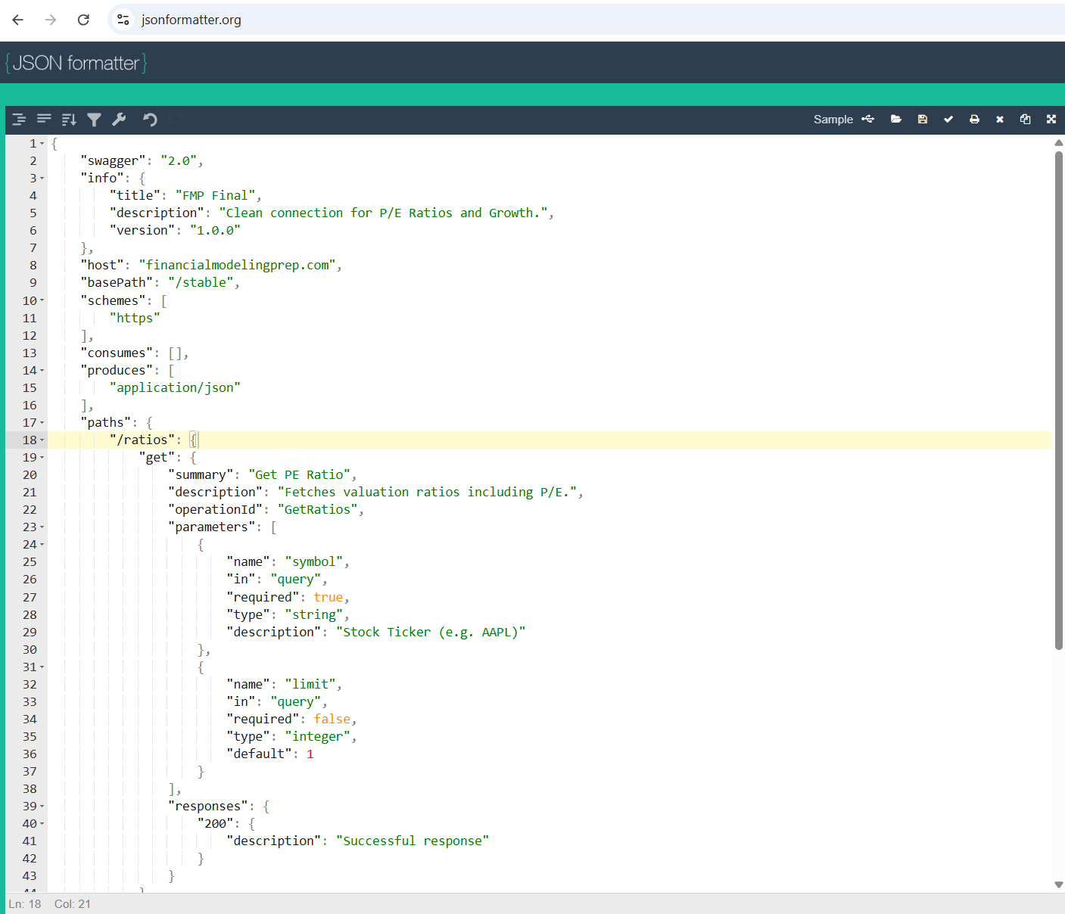
REST API Configuration File
To better read JSON files, use: https://jsonformatter.org/
© All rights reserved for Dr. Ryan Ahmed @Stemplicity Inc.

Slide 7
PRACTICE OPPORTUNITY

Slide 8

Practice Opportunity
Update the JSON definition so the API can also call the “income-statement-growth endpoint” in addition to “ratios”.
Import and configure the updated API in Copilot Studio, then test it by running a request for Tesla (TSLA) income statements growth numbers.
© All rights reserved for Dr. Ryan Ahmed @Stemplicity Inc.

Slide 9
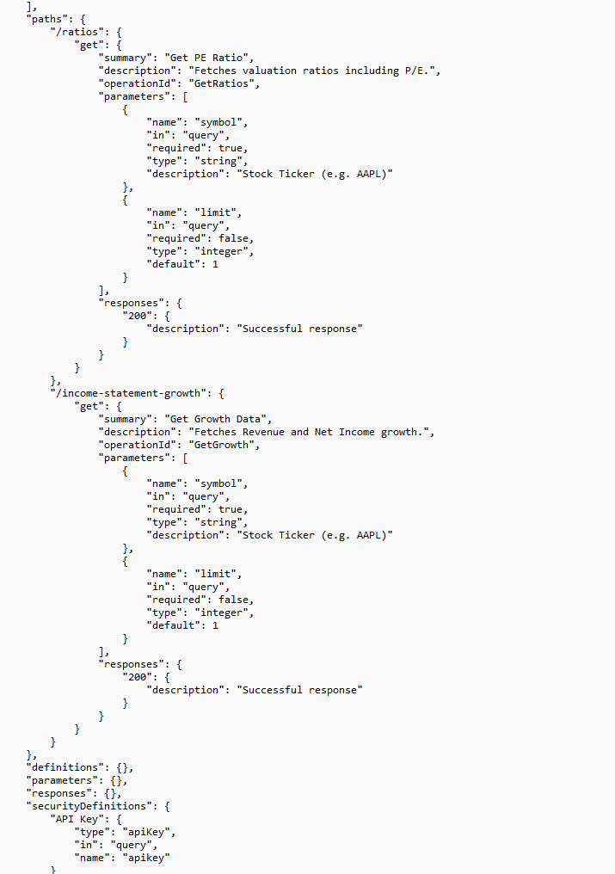
Practice Opportunity Solution
© All rights reserved for Dr. Ryan Ahmed @Stemplicity Inc.

Slide 10

Summary
Designed and deployed an AI Agent in Copilot Studio that can autonomously analyze financial data and generate structured investment reports.
You learned how to convert a prompt into a reusable tool that your Agent can call during complex workflows.
You configured REST API tools inside Copilot Studio to fetch real-time financial data programmatically.
You practiced modifying and extending REST API specifications using JSON to support additional endpoints and data fields.
© All rights reserved for Dr. Ryan Ahmed @Stemplicity Inc.

Slide 11
Thank you!

